Slide 1


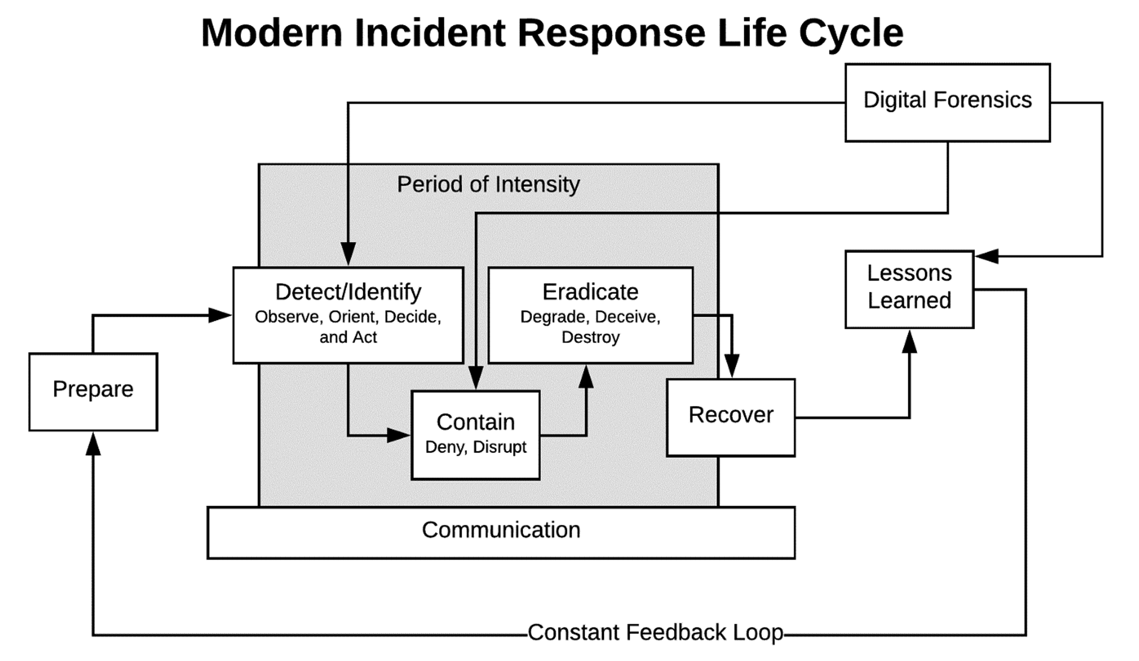
Types of Cyber Attacks and Incident Response
ESP Researcher:
Kaung Myat Thu(Computer System)
Mentor:
Professor Patrick J Slattery (CST)
Abstract:
2. Identification:
5. Eradication and Recovery:
In today's digital age, cyber attacks are a growing threat to individuals, organizations, and governments. Effective incident response is essential to minimize the damage caused by attacks. This research project explores incident response strategies, including preparation, identification, detection and analysis, containment, eradication and recovery, and post-incident activities. The project also examines common types of cyber attacks, such as malware, phishing, ransomware, DDoS attacks, and social engineering, and how incident response can mitigate their impact.
Understanding the various types of cyber attacks is crucial for protecting against them. Common types of attacks include malware, phishing, ransomware, DDoS attacks, and social engineering. Malware is malicious software that can cause damage to or steal sensitive information from computer systems, networks, or devices. Phishing attacks aim to trick users into revealing personal information, such as usernames and passwords. Ransomware encrypts data and demands payment in exchange for a decryption key. DDoS attacks disrupt online services by overwhelming them with traffic. Social engineering attacks exploit human psychology to trick users into revealing sensitive information.
This phase involves identifying potential security incidents through various means. This Include:
Monitoring System Logs: For Incident Response Team to review logs and identify any abnormal activity, such as unauthorized access to sensitive data.
Network Traffic Analysis: To find out any suspicious network activity, such as unusual traffic patterns, port scans, or network connections.
User Behavior Analysis: To detect unusual behavior made by a user, such as unauthorized access attempts, data exfiltration, or use of privileged access.
User Reports: Users may report suspicious activity or incidents to the Incident Response Team. Organizations should have clear procedures in place for users to report incidents or security concerns.
Reliable event identification is critical to information asset protection.
This phase is to restore affected systems to a safe and functional state. This include:
Removing Malware and Threats to affected systems and networks to ensure that all malware, backdoors, or other malicious code have been eliminated. Establishing a reliable environment is critical.
Applying Security Patches and updates to software, firmware, and hardware to ensure that all known vulnerabilities are patched and that the systems are secure. New versions of software can limit exposure.
Restoring Data and Services to their normal state, verifies data integrity, and ensures that backups are up-to-date and functioning correctly.
Testing and Validating systems and networks to ensure that they are operating as expected and that there are no lingering issues or vulnerabilities. The organization needs to know that everything works.
Documenting the Incident, the entire incident response process, including lessons learned and recommendations for future improvements. To be effective in the future, documentation is key.
3. Detection and Analysis:
6. Post-Incident Activity:
Incident Response Steps:
This phase involves to verify whether an attack is occurring and forensic evidence (clues and facts) to determine the nature of the incident and any potential impacts. This Include:
Verifying Potential Threat: Incident Response Team reviews the suspicious activity to identify during the identification phase to confirm whether a security incident is occurring.
Collecting Data: Collecting data or forensic evidence to determine the incident and any impacts such as network logs, memory dumps, or network captures.
Assessing the Scope of the Incident: The team analyzes how many systems or users are affected, what type of data is compromised, and amount of damage to the organization.
This phase is to evaluate the response effort and identify areas for improvement. Example such as conducting a mortem analysis, updating incident response plans, and implementing additional security measures to prevent similar incidents from occurring in the future. This include:
Updating Policies and Procedures: The team updates incident response policies and procedures based on the findings of the lessons learned review.
Training Staff: The team provides training to staff to ensure that they are prepared to respond to future incidents.
Conducting Tabletop Exercises: The team conducts tabletop exercises to test and refine incident response plans and procedures.
Maintaining Incident Response Capability: The team maintains incident response capability by conducting regular assessments of the security environment, identifying potential threats, and ensuring that the incident response plan is up-to-date and relevant.
When a cyber attack occurs, it's important to have an incident response plan in place to minimize the damage and restore normal operations as quickly as possible. Incident response involves a series of steps, including:
Preparation
Identification
Detection and Analysis
Containment
Eradication and Recovery
Post-Incident Activity
1. Preparation:
4. Containment:
This phase involves preparing for potential incidents before they occur. This includes:
Creating an incident response plan
Establishing communication protocols
Identifying critical assets
Establishing training and testing procedures
Setting up tools and infrastructure to assist in incident response.
During the containment phase, IR Team focuses on preventing further damage to critical systems to minimize impact and stopping the spread of the security incident. This may involve isolating affected systems or network segments, disabling compromised user accounts, or shutting down affected services.
Isolating Infected Systems: IR team Isolates infected systems or devices from the network to prevent the spread of malware or other malicious activity. Examples such as: disconnecting network cables or disabling network access.
Blocking Malicious Traffic: IR team blocks or filters malicious traffic, such as traffic associated with a known malware infection or DDoS attack.
Removing Malware: Removes malware or other malicious software from affected systems. This may involve using antivirus software, deleting files or registry entries, or restoring system backups.
Implementing Access Controls: Implement access controls to prevent unauthorized users or devices from accessing critical systems or data. Examples such as: changing passwords or revoking access privileges.
Deploying Countermeasures: This includes updating antivirus software, applying security patches, or reconfiguring network devices.
Verifying Success: IR team verifies everything to make sure that containment has been successful, and the incident has been contaminated. Example such as: conducting scans or tests to confirm that malware and other malicious activity has been removed or blocked. Preventing further damage is an important milestone.
Image by https://pixabay.com/users/vickygharat-1717429/
In conclusion, cyber attacks pose an increasing threat in today's digital age. To protect against them, organizations must be prepared to respond effectively. Understanding common types of attacks, such as malware, phishing, ransomware, DDoS attacks, and social engineering, is essential. Incident response involves several steps, including preparation, identification, detection and analysis, containment, eradication and recovery, and post-incident activity. By following these steps, organizations can minimize the damage caused by an attack and restore normal operations quickly. Post-incident activities, such as updating policies and procedures, training staff, and conducting exercises, are also essential for improving incident response. Overall, having a complete incident response plan is critical for protecting against cyber attacks and minimizing their impact.

